Slide 1


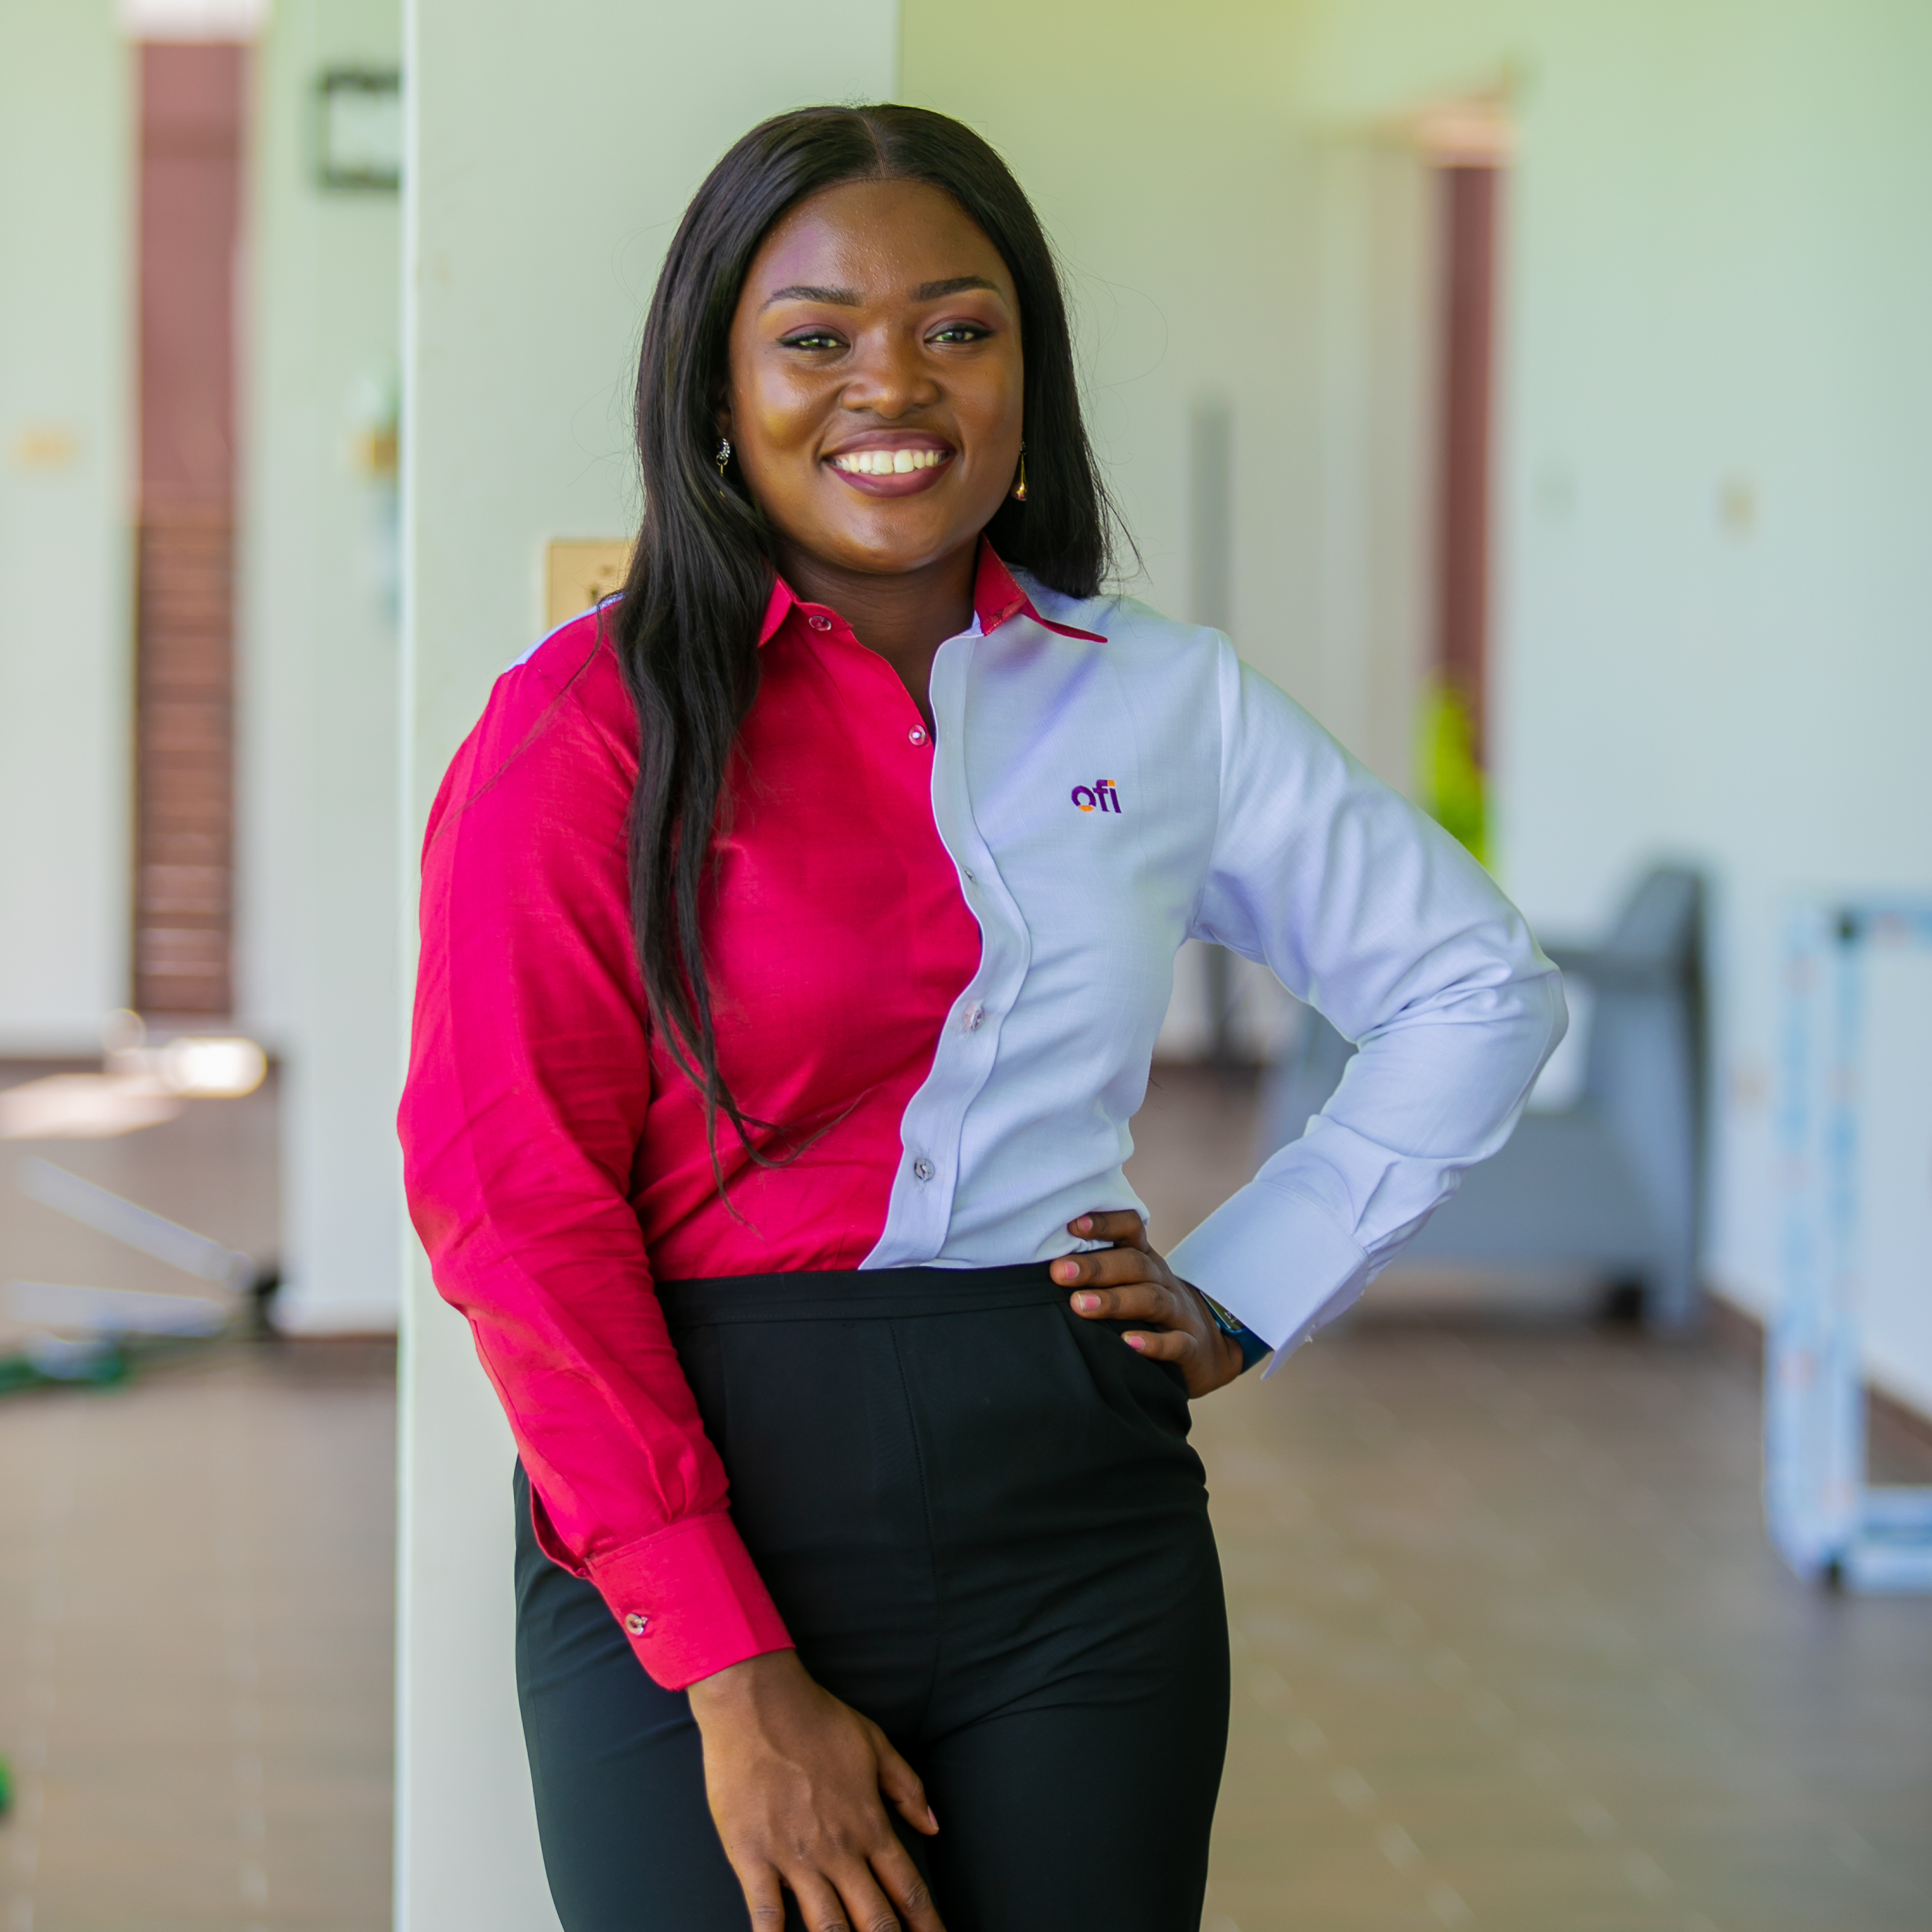
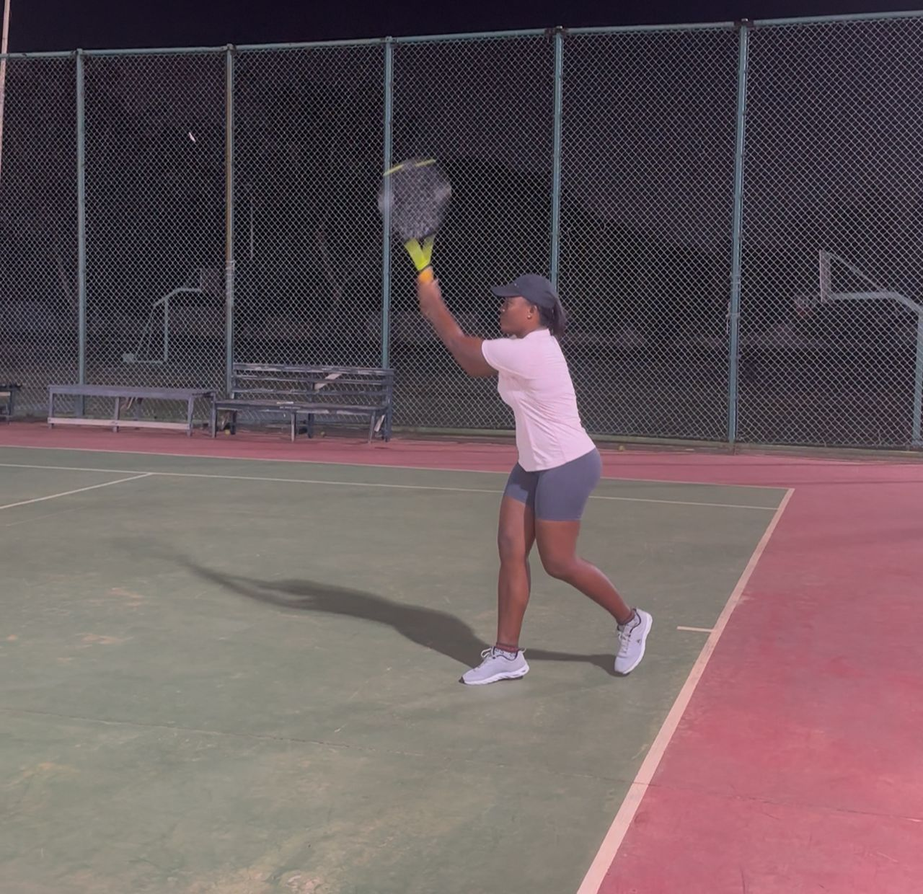
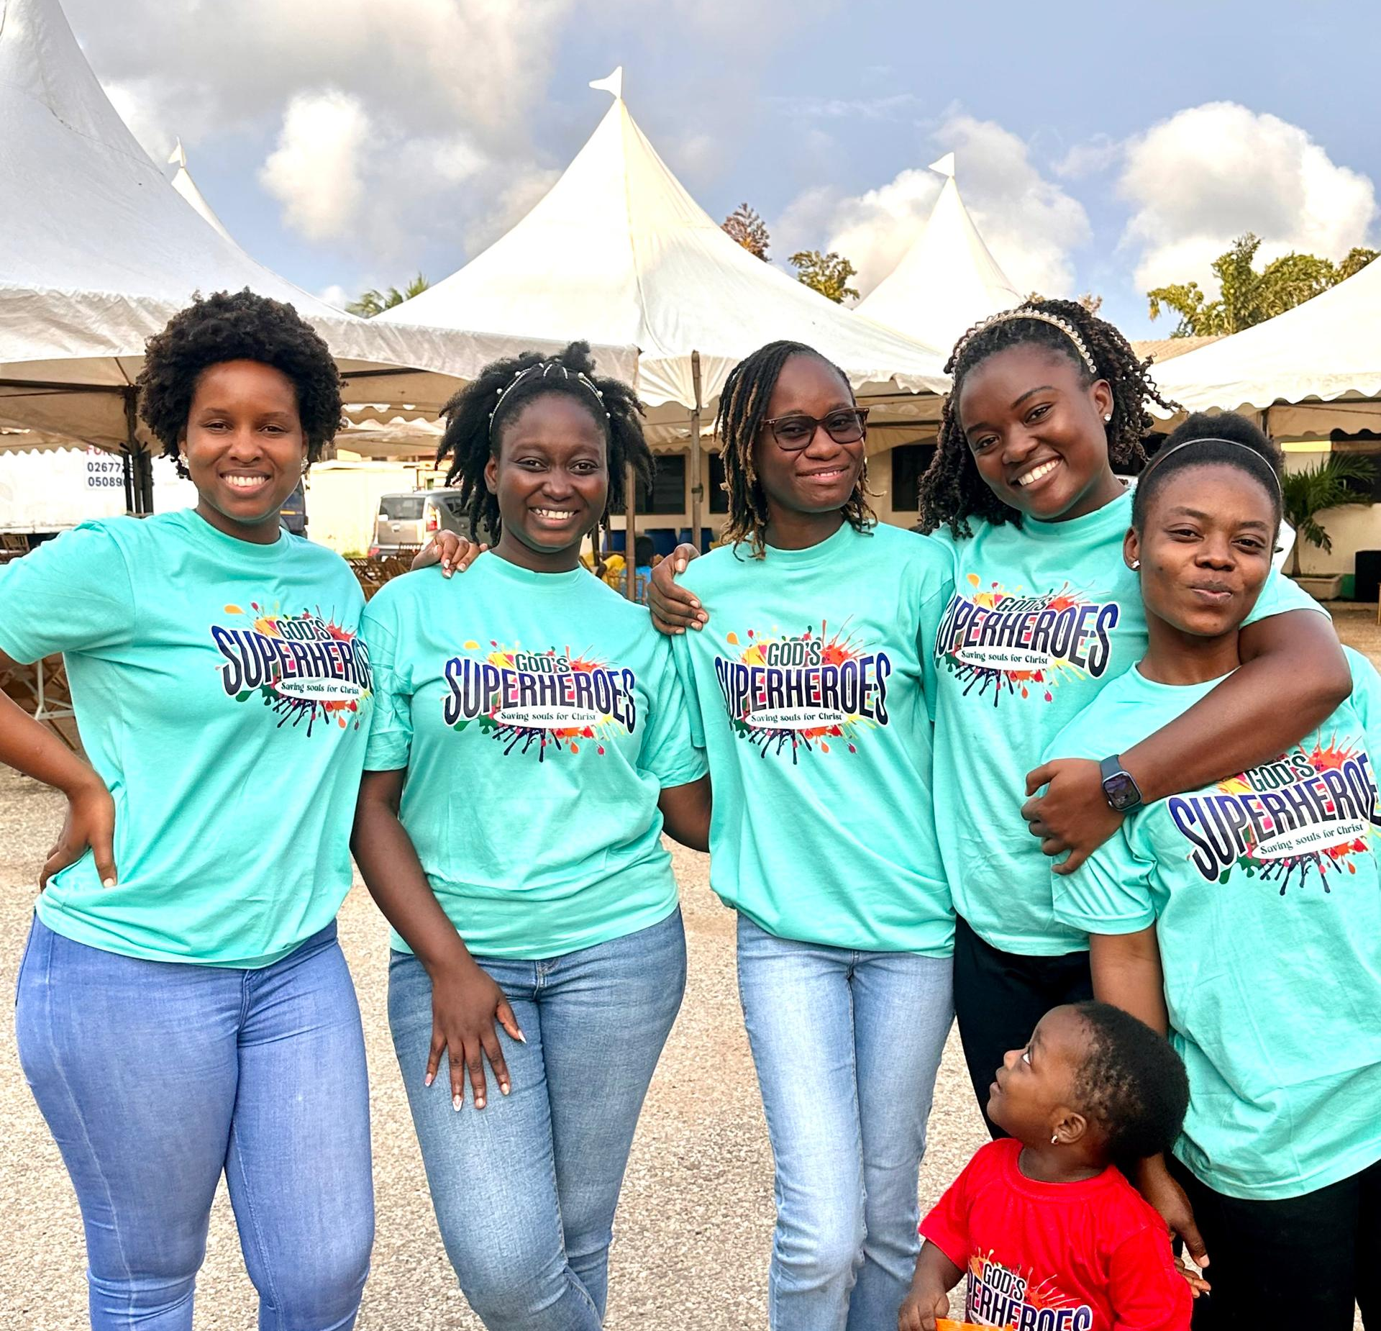
Getting to Know Me
Work
Personal
My role
HR Business Partner - Cashew
Significant others/family members / furry friends in my life
Vivian Akua Mensah
Joy Asare - Kumi
Tenure in ofi/Olam
6 years
How I enjoy spending my free time
Watching Movies, Dancing, chatting with my mum and hosting friends/Events
Previous companies I have worked at
Data Protection Commission
My favorite / comfort food
Kenkey with assorted proteins
Why I joined ofi/Olam and what keeps me here?
I joined ofi to be part of a people-driven organisation where I could grow, contribute meaningfully, and lead initiatives that impact both employee experience and business outcomes. The role gave me space to blend HR strategy with engagement and internal communications, which are areas I truly enjoy.
My favourite song
For my good – Maveric City music
Anita Afoley Mensah
‘what name you prefer to be called’
Afoley or Moments
A few fun facts about me
A foodie
Likes travelling
Loves dancing
Likes car Karaoke
Love kids and teach Sunday school
Like trying new things
This is me outside work, doing stuff I enjoy in my life …

Slide 2
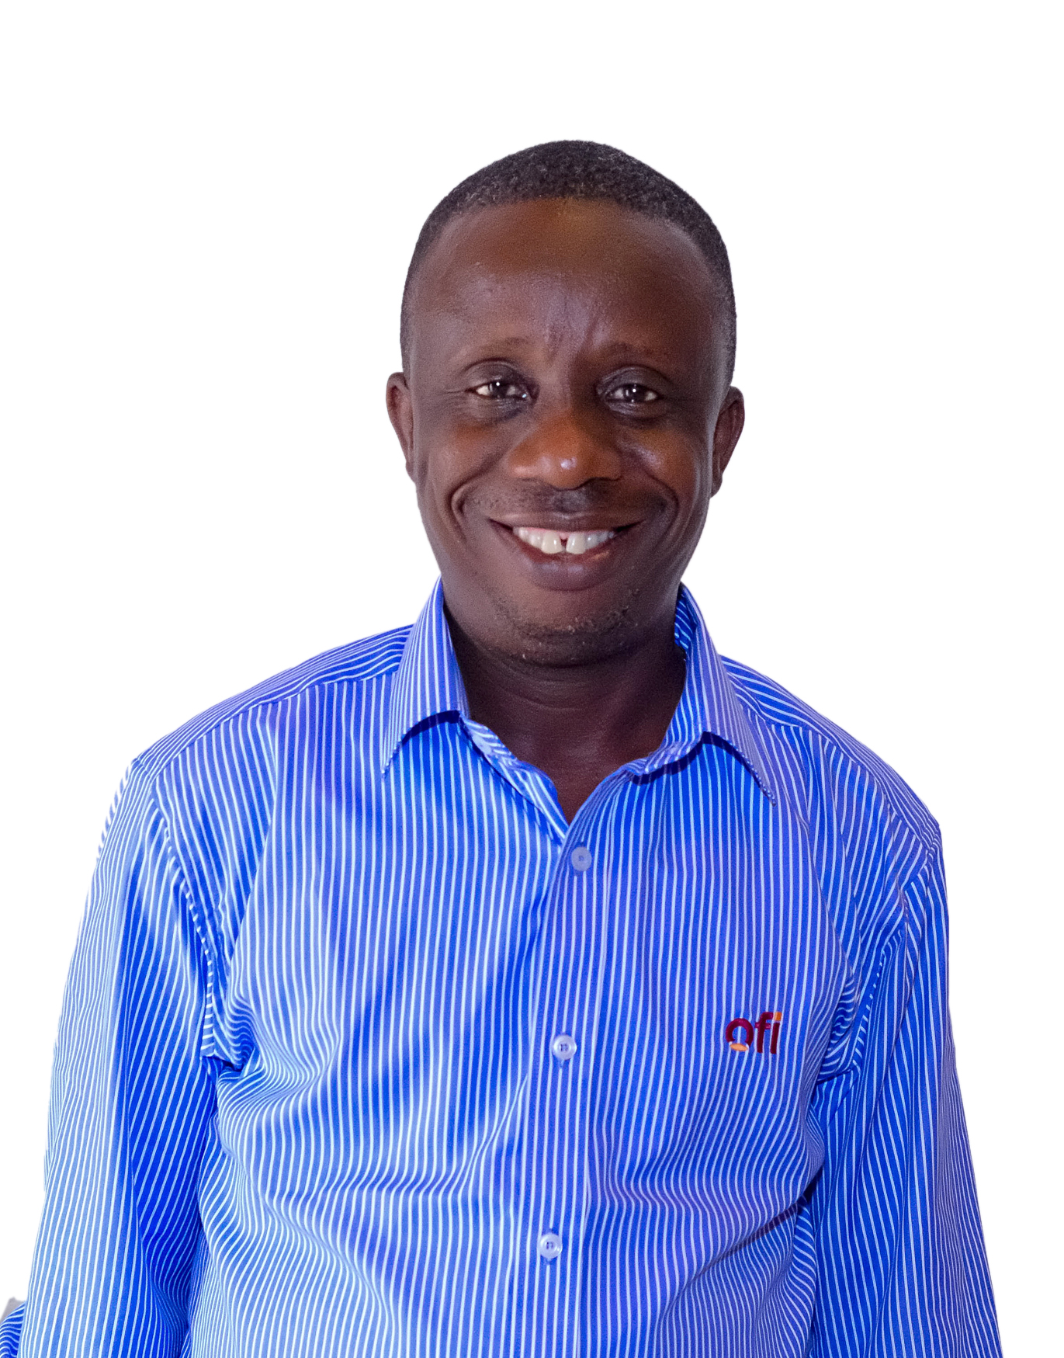
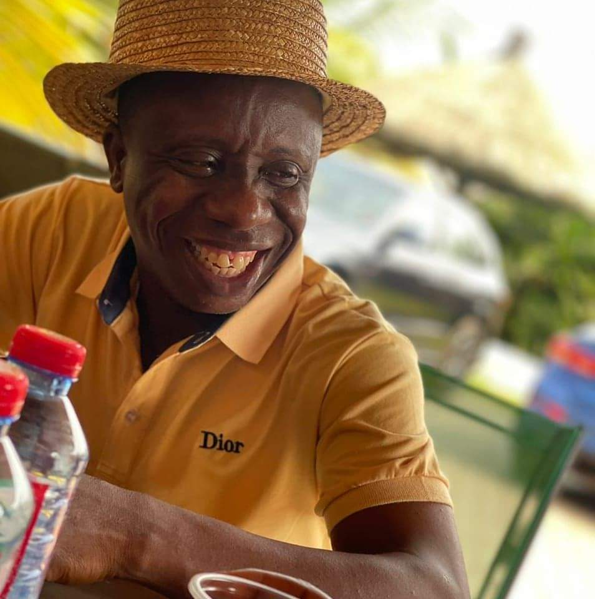
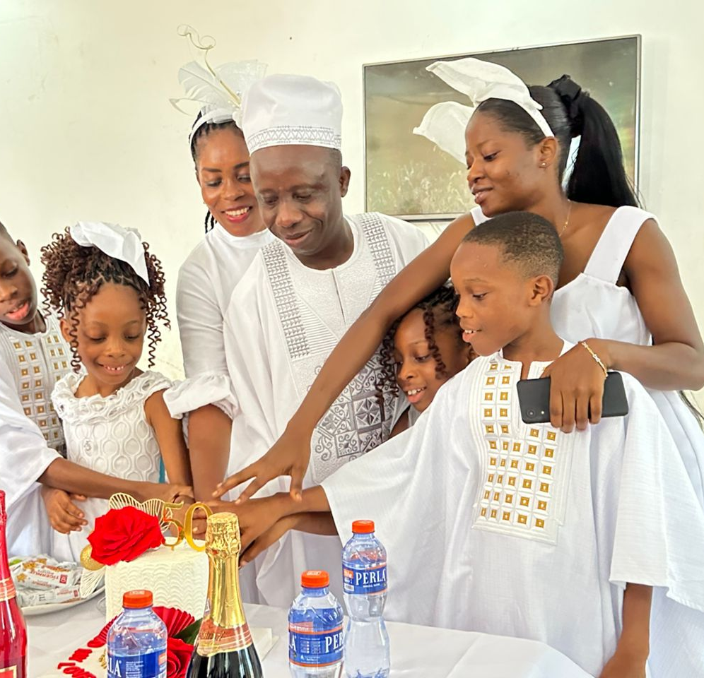
Getting to Know Me
Work
Personal
T
With family
My role
Shipping Manager (Cashew)
Significant others / family members / furry friends in my life
My wife and kids
Tenure in ofi/Olam
15 years
How I enjoy spending my free time
Reading, indoor games, hanging out with family
Previous companies I have worked at
Allship Logistics Ghana Ltd
My favorite / comfort food
Fufu with light soup
Why I joined ofi/Olam and what keeps me here?
To align myself with OFI values, teamwork and career growth.
My favorite song
Any good gospel music
John Clinson Nyarko
“ I prefer to be called John’
A few fun facts about me
I like taking exercise each morning, crack jokes with the family, coworkers.
This is me outside work, doing stuff I enjoy in my life …

